Slide 1


Slide 2


WebService Testing using SoapUI

Slide 3
What is WebService?
Web Services is the mechanism or the medium of communication through which two applications / machines will exchange the data irrespective of their underline architecture and the technology.
Example:
http://wsf.cdyne.com/WeatherWS/Weather.asmx?WSDL
It gives Weather Information.

Slide 4
WebService Implementation
WebService can be called by a Software Application using SOAP or HTTP protocol.
Web Services can be implemented in different ways, but the following two are the popular implementations approaches.
  SOAP (Simple Object Access Protocol)
  REST (Representational State Transfer architecture)

Slide 5
SOAP
SOAP is a standard protocol defined by the W3C Standard for sending and receiving web service requests and responses.
SOAP uses the XML format to send and receive the request and hence the data is platform independent data. SOAP messages are exchanged between the provider applications and receiving application within the SOAP envelops.
As SOAP uses the simple http transport protocol, its messages are not got blocked by the firewalls.

Slide 6
REST
REST means REpresentational State Transfer; it is an architecture that generally runs over HTTP.
REST is an alternative to SOAP (Simple Object Access Protocol) and instead of using XML for request REST uses simple URL in some cases.
Unlike SOAP, RESTFUL applications uses HTTP build in headers to carry meta-information.
Rest API supports both XML and JSON format.
It is usually preferred for mobile and web apps as it makes app work faster and smoother

Slide 7
WSDL
WSDL (Web Services Description Language) is an XML based language which will be used to describe the services offered by a web service.
WSDL describes all the operations offered by the particular web service in the XML format. It also defines how the services can be called.

Slide 8
WebService Testing
Web Services Testing basically involves
  Understand the WSDL file
  Determine the operations that particular web service provides
  Determine the XML request format which we need to send
  Determine the response XML format
  Using a tool or writing code to send request and validate the response

Slide 9
What is soapUI?
SOAP-UI is the leading open source cross-platform API Testing tool.
SOAP-UI allows testers to execute automated functional, regression, compliance, and load tests on different Web API.
SOAP-UI supports all the standard protocols and technologies to test all kinds of API's.
SOAP UI interface is simple that enables both technical and non-technical users to use seamlessly.
More on soapUI on http://www.soapui.org .

Slide 10
Download & Install
Download whatever version of soapUI you wish from http://www.soapui.org according to your system (Linux-Windows)
Install it according to the instructions on your system.

Slide 11
Configure
Step 1: Create a Work Space.
Step 2: Enter a name for the Work Space.
Step 3: Select the path where this work space has to be saved.
Step 4:Access the workspace properties under 'Workspace Properties‘ Tab.

Slide 12
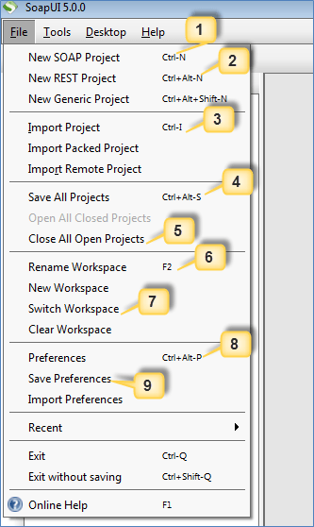
Basic UI Navigation
File Menu
'New SOAP Project' allows user to create a Project by importing SOAP Request.
'New REST Project' allows user to create a Project by importing REST Request.
'Import Project' allows user to import the entire project by locating the corresponding XML.
'Save All Projects' allows user to save all the opened projects in a single click.
'Close All Open Projects' closes all the projects opened in that workspace.
'Rename Workspace' allows user to rename the previously created workspace.
'Switch Workspace' allows user to switch between workspaces.
'Preferences' allows user to customize SOAP UI. We will deal with it in next section.
'Save Preferences' allows user to save their customized settings. When SOAP UI opened for the next time, it uses the user saved preferences.

Slide 13
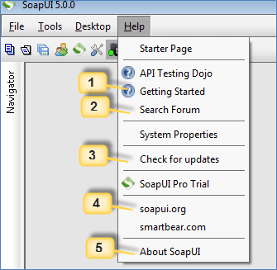
Basic UI Navigation
Help Menu
Shows the home page of the online help available at www.soapui.org
Allows registered users to post questions in forum and get online help from the community.
Checks for the recent updates and installs if there it is available.
Allows user to navigate to the home page of www.soapui.org
Displays the build and version information of the SOAP UI.

Slide 14
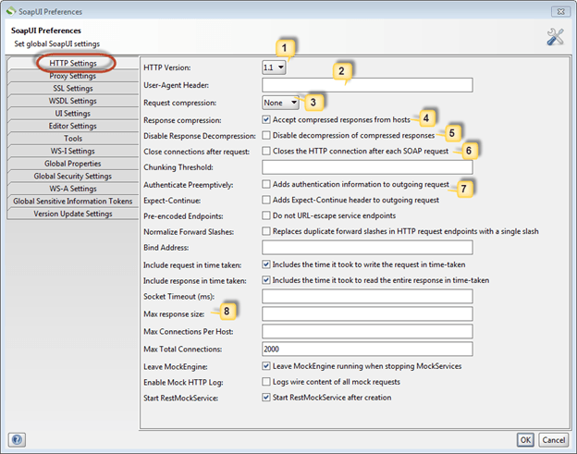
Basic Settings
File >> Preferences >> Http Settings
Denotes the HTTP Version to be used for request and response.
'User-Agent Header' allows user to can be predefined using this option. If not defined, it uses the default http client header.
Allows user to specify the compression method. It can be either gzip or deflate or None.
'If Checked', allows compressed response from hosts.
'If Checked' disables decompression of the compressed responses.
'If Checked' closes HTTP connection for each SOAP Request.
'If Checked', allows user to specify authentication information for the outgoing requests.
Allows user to restrict the maximum number of bytes to be read from a response. ZERO corresponds to unlimited size.

Slide 15
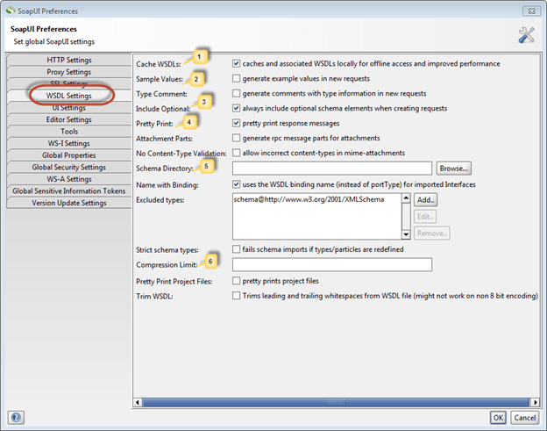
Basic Settings
File >> Preferences >> WSDL Settings
Cache WSDLs Turns on and off caching of WSDL's
Generates example values in requests
Allows users to always include optional elements in generated requests
Response messages are printed in the response editor
Allows user to specify a directory containing schema (.xsd) files while validating WSDL requests. Upon changing the contents of this directory SOAP UI requires a restart.
For the purpose of preserving space, the minimum message size to be compressed in the SoapUI project file.

Slide 16
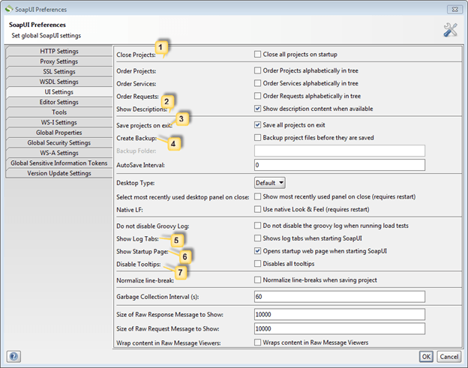
Basic Settings
File >> Preferences >> UI Settings
Closes all projects while launching SOAP UI for better startup-time and consumes less memory.
Displays description whenever available.
Automatically saves all projects while exiting SOAP UI.
Before saving, SOAP UI creates a backup of the project. If enabled, back up folder has to be mentioned.
Displays and expands the log tabs upon starting SOAP UI.
Displays the 'start up page' dialog upon starting SOAP UI.
Upon disabling tool tip, disables tool tip when user hovers mouse over the options/buttons while navigation.

Slide 17
Creating Test Suite
Step 1: Within the project, testers can create a test suite by performing a right click on the root of the project.
Step 2: Enter the name of the test suite and press OK.

Slide 18
Creating Test Case
Step 1: Within a test suite, we can create multiple tests by performing right click on the 'test suite' and choosing 'New Test Case'.
Step 2: Specify the name of the test case and click 'OK'.
Step 3: The created test case will show zero steps.

Slide 19
Creating Test Step
Step 1: Within a test case, we can create multiple test step by performing right click on the 'test case' and choosing Add Step‘ and ‘test Request’.
Step 2: Specify the name of the test step and click 'OK'.
Step 3: Upon clicking 'OK', a dialog pops up to select the operation to invoke. All the operations are listed, and user can select the operation that they would like to invoke.

Slide 20
What is an Assertion?
Assertion means act of affirming or stating something. It can also be interpreted as check point or a validation point.
Once a request is sent to a web server a response is received. We need to validate if the response contains the data that we expect. In order to validate the response, we need to use assertions.

Slide 21
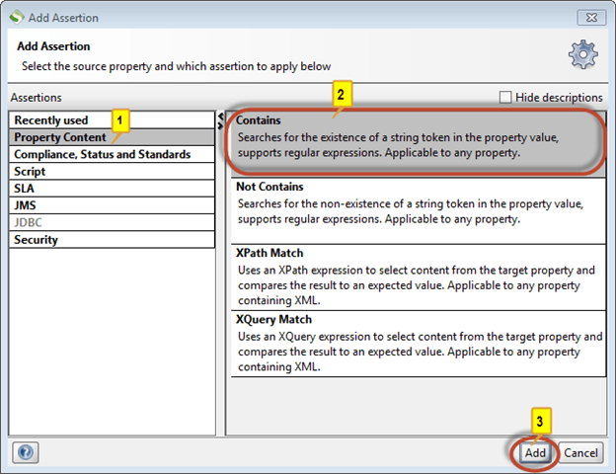
Types of Assertions
Contains Assertion
Not contains Assertion
X Path Match Assertion.
X Query Match Assertion
Scripting Assertion

Slide 22


